Slide 1
FINANCIAL RESULTS
H1 2022/23
MERCOR

Slide 2
Notes:
#1 in the segment of passive fire protection technology in Europe - Numer 1 w segmencie technologii pasywnych zabezpieczeń przeciwpożarowych w Europie
11 Group companies - 11 spółek w Grupie
Serving more than 50 markets worldwide - Obsługa ponad 50-ciu rynków na świecie
Over 30,000 square metres of production space - Ponad 30 000 m2 powierzchni produkcyjnej
Located on 16 hectares of storage area - Zlokalizowane na 16 ha terenów składowania
Belonging to 7 production plants - Przynależących do 7-miu zakładów produkcyjnych
4 system solution groups - 4 systemowe grupy rozwiązań
natural smoke exhaust systems - oddymianie grawitacyjne
fire ventilation systems - wentylacja przeciwpożarowa
fire protections of building structures - zabezpieczenia przeciwpożarowe konstrukcji budowlanych
fire partitions, fire-rated doors and gates (DFM Doors) - oddzielenia przeciwpożarowe (DFM Doors)
Continued product development through expansion of the automation, software and production process segment - Stały rozwój oferowanych rozwiązań poprzez rozszerzanie segmentu automatyki, oprogramowania i procesów produkcyjnych
Deployment of IT and Industry 4.0 solutions to streamline production - Produkcja wsparcia rozwiązaniami IT oraz Przemysłu 4.0
(including through MCR Techlab); operations supported by ERP, Vault, Shop Floor systems - (w którym uczestniczy spółka MCR Techlab); praca w oparciu o systemy ERP, Vault, Shop Floor:
Close to 800 headcount across the Group - Blisko 800 pracowników w Grupie

Slide 3
01.
H1 2022/23 HIGHLIGHTS
Strong revenue growth (31%); sales in Poland up almost 36% and export sales up 26%
Improved earnings and profitability: net profit up 30% despite a challenging market environment; gross margin at 25.9% (vs 24.6% a year earlier)
Safe order levels: order intake of around PLN 302.2m in April to September 2022 (up 15%)
Implementation of Fire Safety 4.0 technology through MCR Tech Lab (established in 2022)
Development of energy storage systems through Elmech ASE
Further geographic and product diversification, new markets, product innovations
FY 2021/22 dividend payment of PLN 0.63 per share
Ongoing review of strategic options

Slide 4
STRATEGY
Notes:
Strategy- Strategia

Slide 5
STRATEGY EXECUTION 1/3
RESULTS:
31% sales growth
Net debt/EBITDA = 1.1x
ROE = 20.72% (vs strategic target of 13%)
SHAREHOLDERS:
Dividend policy – ca. 30% of net profit
FY 2021/22 dividend payment of PLN 0.63 per share
Ongoing share buyback programme
MARKET:
Stepping up exports
Maintaining leadership in PL and a top position among leading players in Europe

Slide 6
STRATEGY EXECUTION 2/3
PRODUCTS:
Automation of multiple fire safety systems
DFM Doors: secured certificates for gates, confirmed aspirations to be a leader in the manufacture of industrial-grade doors and gates
Further certificates obtained for mcr Silboard boards; new applications researched
30 R&D projects underway
The new offering of energy storage systems well received by the market
Development of Fire Safety 4.0 technology through MCR Tech Lab

Slide 7
STRATEGY EXECUTION 3/3
BUSINESS MODEL:
Building on high-quality engineering expertise – the Group designs and manufactures custom solutions to meet specific customer needs.
The first company in Poland to implement Fire Safety 4.0 technology
SUSTAINABILITY:
Increasing energy efficiency and lowering carbon footprint
Bringing online of a 1MW solar farm (covering the electricity demand of the Cieplewo plant and the Gdańsk office) and two 50kWp PV systems at the plants located in Cieplewo and near Płock
Plans to use Elmech energy storage systems at the Group’s plants and offices

Slide 8
FINANCIAL RESULTS
H1 2022/23
04.

Slide 9
04.
DOUBLE-DIGIT SALES GROWTH POSTED BY THE GROUP
Quarterly sales [PLNm]
H1 2022/23 sales [PLNm]
+33% YoY
+31% YoY
2019/2020
2020/2021
2021/2022
H1 2022/23: double-digit sales growth in Poland (up 36% YoY) and abroad (26% YoY)
Order book in H1 2022/23 up 15% YoY to PLN 302.1m

Slide 10
GROUP SALES BY GEOGRAPHY
H1 2021/22 sales [%]
H1 2022/23 sales [%]
Ukraine
UK
Romania
UK
Romania
Ukraine
Czech Republic and Slovakia
Czech Republic and Slovakia
Poland
Hungary
Other
Poland
Other
Hungary
Spain
Spain
Russia
Russia

Slide 11
COSTS ALIGNED TO SCALE
Quarterly costs [PLNm]
H1 2022/23 costs [PLNm]
+28% YoY
266.5
+25% YoY
208.8
+19% YoY
+29% YoY
2019/2020
2020/2021
2021/2022
Costs aligned to the growing scale of business
H1 2022/23: SG&A costs growing slower (close to 25% YoY) than revenue (up 31% YoY); Q2 alone: SG&A up 23% vs revenue up 33% YoY
Higher external costs due to soaring material prices and wage pressure

Slide 12
GROUP RESULTS
Quarterly EBITDA [PLNm]
H1 2022/23 EBITDA [PLNm]
+46% YoY
2019/2020
2020/2021
2021/2022

Slide 13
STRONG NET PROFIT GROWTH
Quarterly net profit [PLNm]
H1 2022/23 net profit [PLNm]
+28% YoY
+30% YoY
2019/2020
2020/2021
2021/2022
Q2 2022/23 net profit up almost 28%
Net profit growth posted in both Q2 and H1, with business growth achieved despite rising material prices through tight cost discipline, product range expansion, and efficient pass-through of a portion of costs to final product price

Slide 14
SOLID PROFITABILITY IN A CHALLENGING ENVIRONMENT
Quarterly profitability [%]
H1 2022/23 profitability [%]
Solid profitability despite a continued challenging market environment – focus on cost discipline

Slide 15
STABLE LIQUIDITY POSITION
Cash flow [PLNm]
H1 2021/22
H1 2022/23
Low debt level
Cash at PLN 38.1m with outstanding bank debt at PLN 91.9m

Slide 16
SAFE DEBT LEVEL
Net debt [PLNm] and net debt/EBITDA ratio
Continued low net debt/EBITDA ratio: 1.1x with the strategic target of not more than three times EBITDA
* as at September 30th 2022

Slide 17
04.
Notes:
A future based on orders - Przyszłość oparta na zamówieniach

Slide 18
ORDERS
Over 15% year-on-year improvement in the order book in H1 2022/2023, to PLN 302.1m
Short lead times (ca. 2–3 months on average)

Slide 19
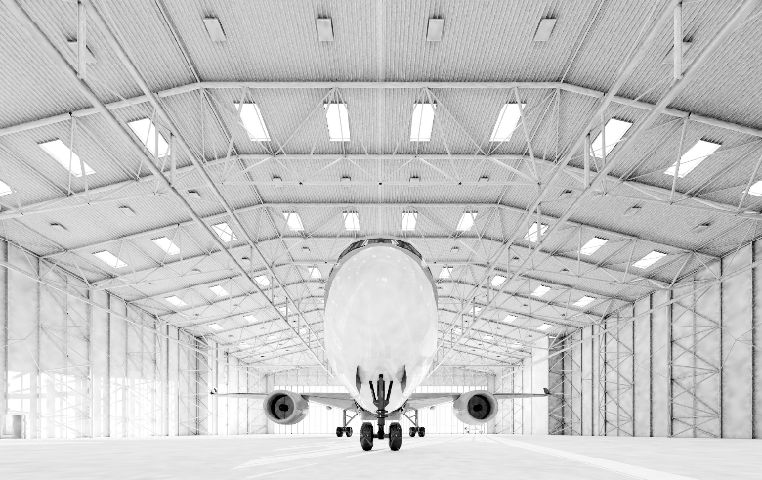
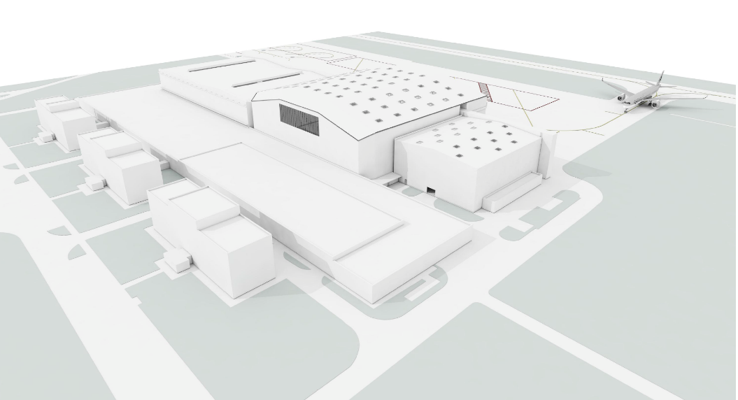
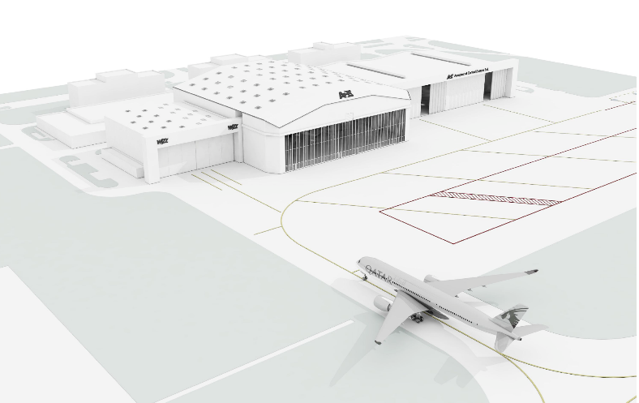
01.
COMPLETED PROJECTS
ACE hangar building at Budapest Airport: 56 smoke vents, 48V operating system.

Slide 20
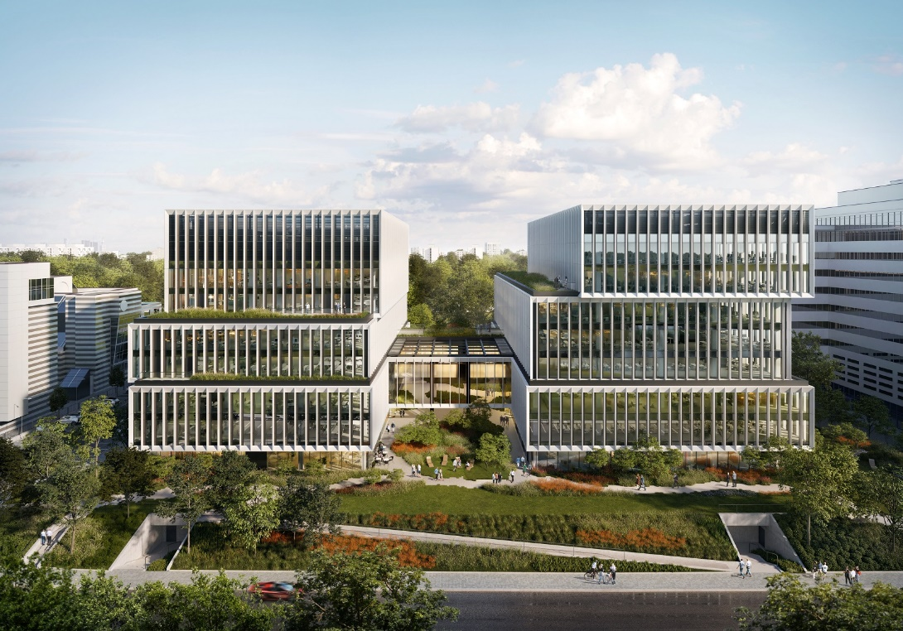
01.
COMPLETED PROJECTS
Lakesade Office Building, ul. Szturmowa, Warsaw, Poland
950 fire dampers
15 EXiF exit route pressurisation systems
mcr OMEGA PRO automated control system for fire dampers

Slide 21
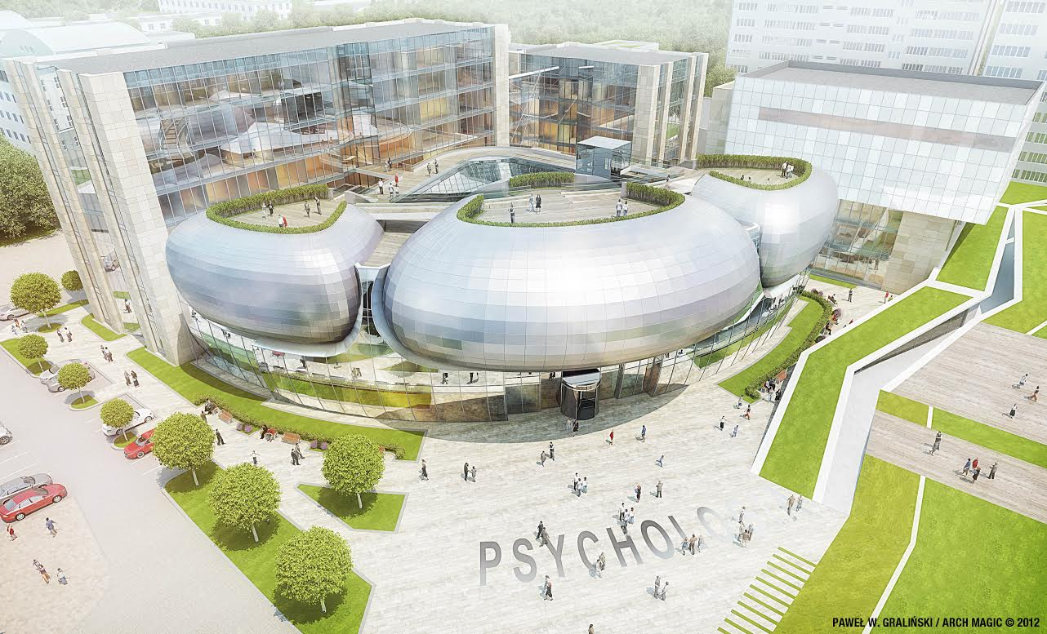
01.
COMPLETED PROJECTS
Faculty of Psychology, University of Warsaw – research lab and classroom building, Ochota Campus, Warsaw, Poland:
fire dampers
14 smoke exhaust fans
22 jet fans
4 EXiF exit route pressurisation systems
5 mcr OMEGA PRO power and control units for fire protection equipment

Slide 22
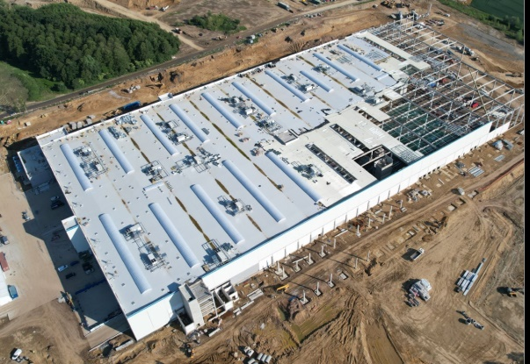
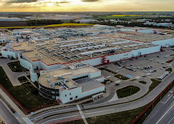
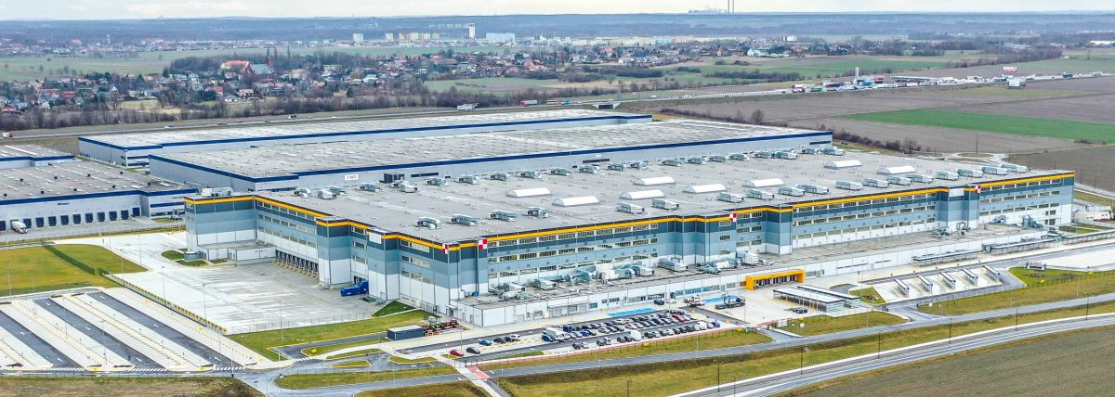
01.
COMPLETED PROJECTS
Gorzyczki – a project for Amazon: continuous rooflights: 6,900.0 square metres, 50 smoke vents within continuous rooflights and 25 spot smoke vents, and an electric and pneumatic smoke vent control system
Nowa Wieś Wrocławska Phase 8 – a project for Nestle Purina: continuous rooflights: 1,900.0 square metres, 60 smoke vents, and an electric and pneumatic smoke vent control system
Świebodzin – a project for Amazon: continuous rooflights: 1,400.0 square metres, 240 spot smoke vents, 10 skylights, and an electric and pneumatic smoke vent control system

Slide 23
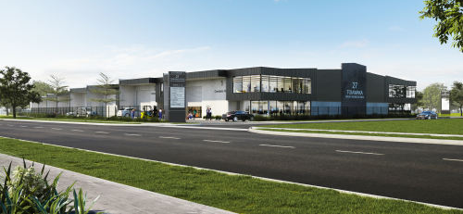
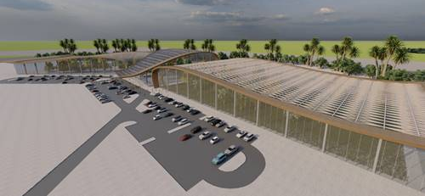
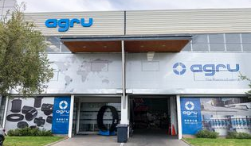
01.
COMPLETED PROJECTS
Sales to New Zealand – Ventuer, 2 Toiowaka Road, Auckland, warehouse, 8x LAM louvred smoke vents
Expanding business relationship with Naffco – Naffco,UAE, Al Rabha Greenhouse, 84x Prolight smoke vents (single and double leaf)
First sales generated from the Feuertrutz Trade Fair – RWA Licht- und Lüftungstechnik GmbH, Agru Werk 6, warehouse (renovation), 46x LAM louvered façade vents

Slide 24
PRODUCT RANGE EXPANSION AND INNOVATIONS
03.

Slide 25
01.
MCR TECH LAB
Award for MCR Tech Lab’s Advanced Fire Monitoring System received during the URBAN TECH hackathon accelerator programme for European start-ups
Collaboration with Gdańsk University of Technology in scientific research of industrial safety systems
First commercial orders to apply IoT in fire safety systems

Slide 26
01.
SUMMARY
Strong sales, satisfactory order book
Improved earnings and profitability
Continued product range expansion: implementation of Fire Safety 4.0 technology and development of energy storage systems
Plans of further operational optimisation, including through spin-off of the shared services centre, etc.
Further geographic and product diversification
FY 2021/22 dividend payment of PLN 0.63 per share
Ongoing review of strategic options

Slide 27
Notes:
ENG- This material is intended for information purposes only. It does not constitute an advertisement for or an offer of any publicly traded securities. Its contents have been compiled from sources considered reliable and accurate by MERCOR S.A., although no assurance can be given that such sources are exhaustive or fully reflect the underlying facts. This document may contain some forward-looking statements, which represent an investment risk or a source of uncertainty and may differ materially from actual results. MERCOR S.A. shall not be held liable for the consequences of any decisions made in reliance on this material. Responsibility for its use shall lie solely with the user. This document is protected under the Copyright and Related Rights Act of February 4th 1994 (Dz.U. No. 24, item 83, as amended). Any reproduction, publication or dissemination of this material requires MERCOR S.A.’s prior written consent.
PL- Niniejsze opracowanie zostało sporządzone wyłącznie w celach informacyjnych. Nie stanowi reklamy ani oferowania papierów wartościowych w publicznym obrocie. Zostały w nim wykorzystane źródła informacji, które „MERCOR" S.A. uznaje za wiarygodne i dokładne, jednak nie ma gwarancji, że są one wyczerpujące i w pełni odzwierciedlają stan faktyczny. Opracowanie może zawierać stwierdzenia dotyczące przyszłości, które stanowią ryzyko inwestycyjne lub źródło niepewności i mogą istotnie różnić się od faktycznych rezultatów. „MERCOR" S.A. nie ponosi odpowiedzialności za efekty decyzji, które zostały podjęte na podstawie niniejszego opracowania. Odpowiedzialność spoczywa wyłącznie na korzystającym z opracowania. Opracowanie podlega ochronie wynikającej z ustawy o prawie autorskim i prawach pokrewnych z ustawy z dnia 4 lutego 1994 r. o prawie autorskim i prawach pokrewnych (Dz. U. Nr24, poz. 83,z późn.zm). Powielanie, publikowanie lub jego rozpowszechnianie wymaga pisemnej zgody „MERCOR" S.A.

Slide 28
Notes:
Thank you! - Dziękujemy za uwagę

